Slide 1
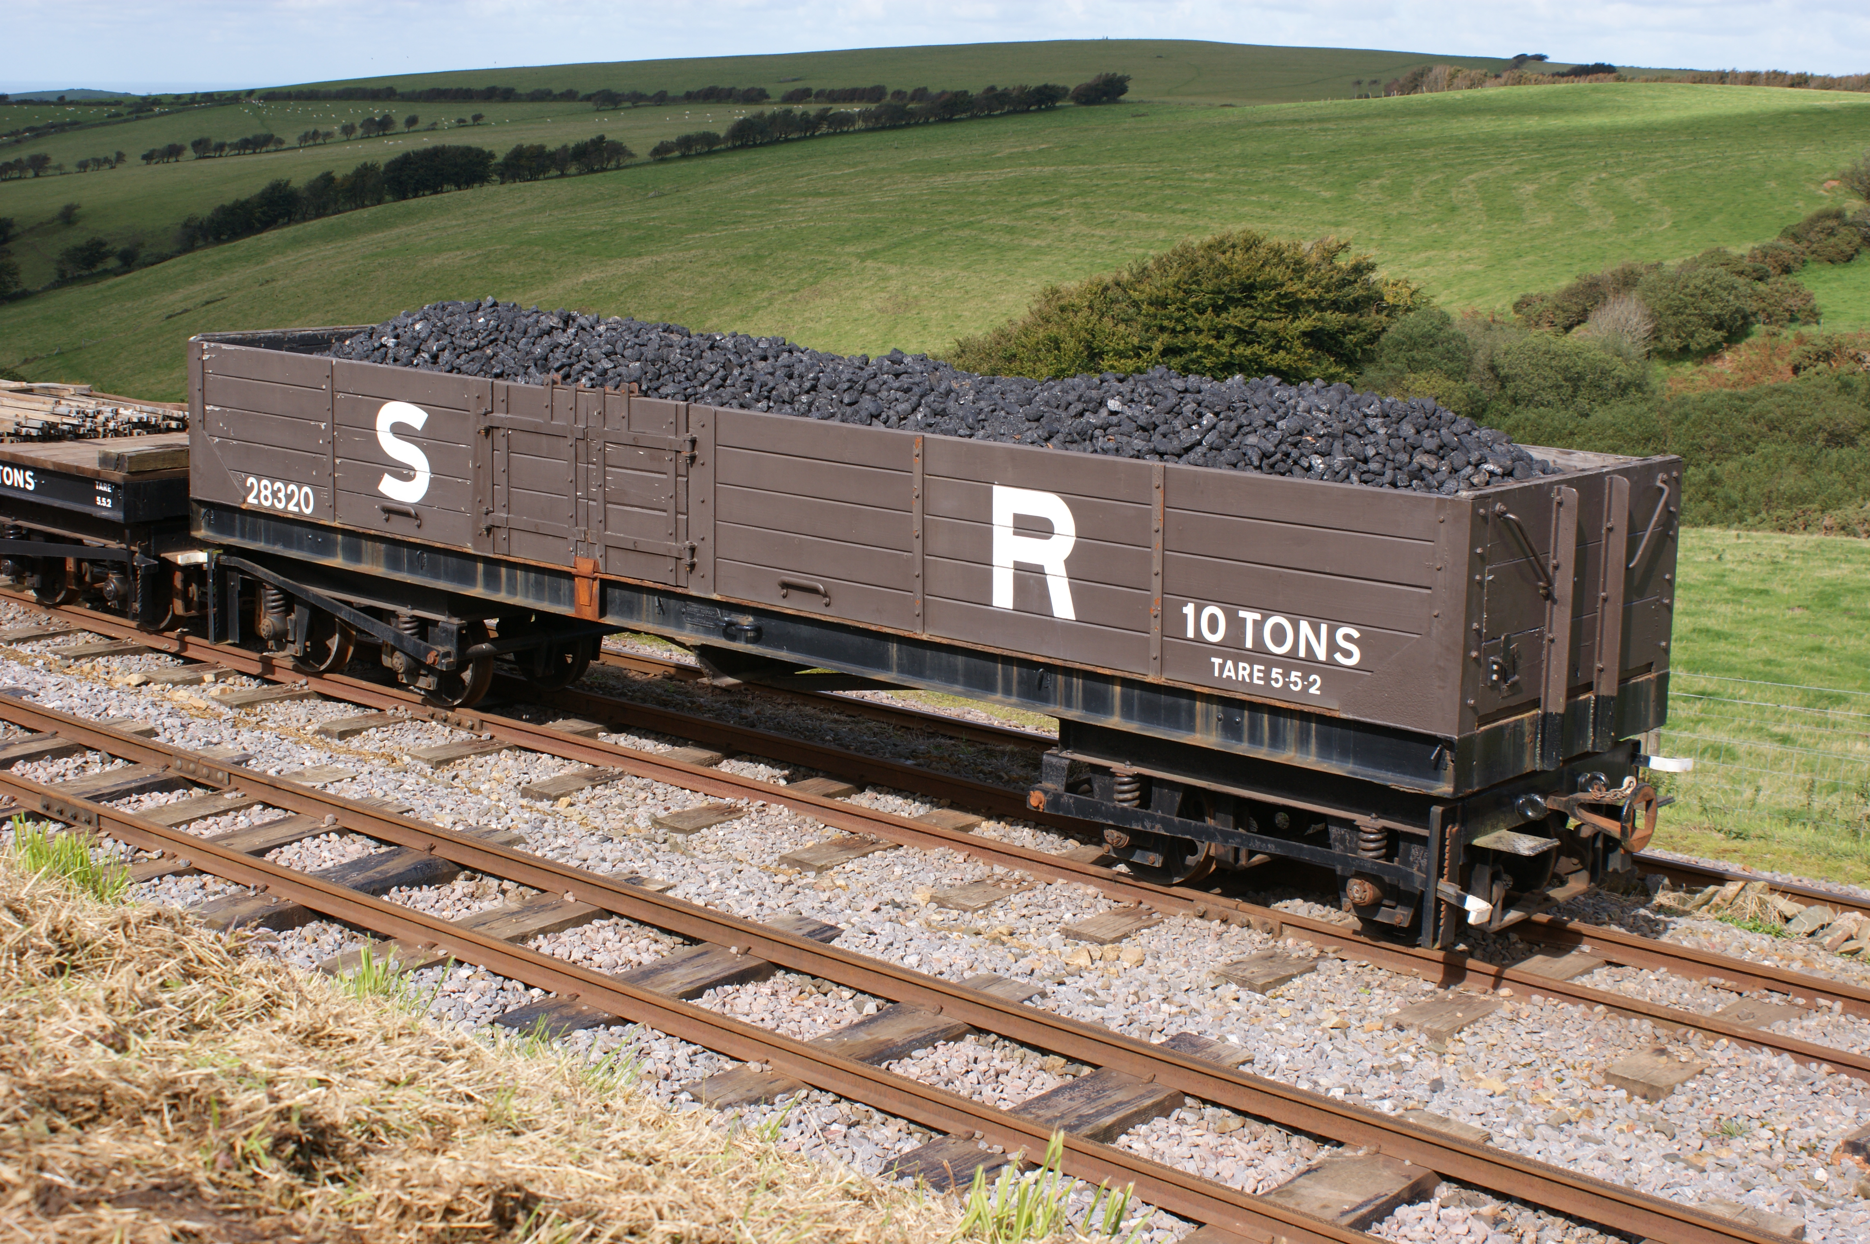
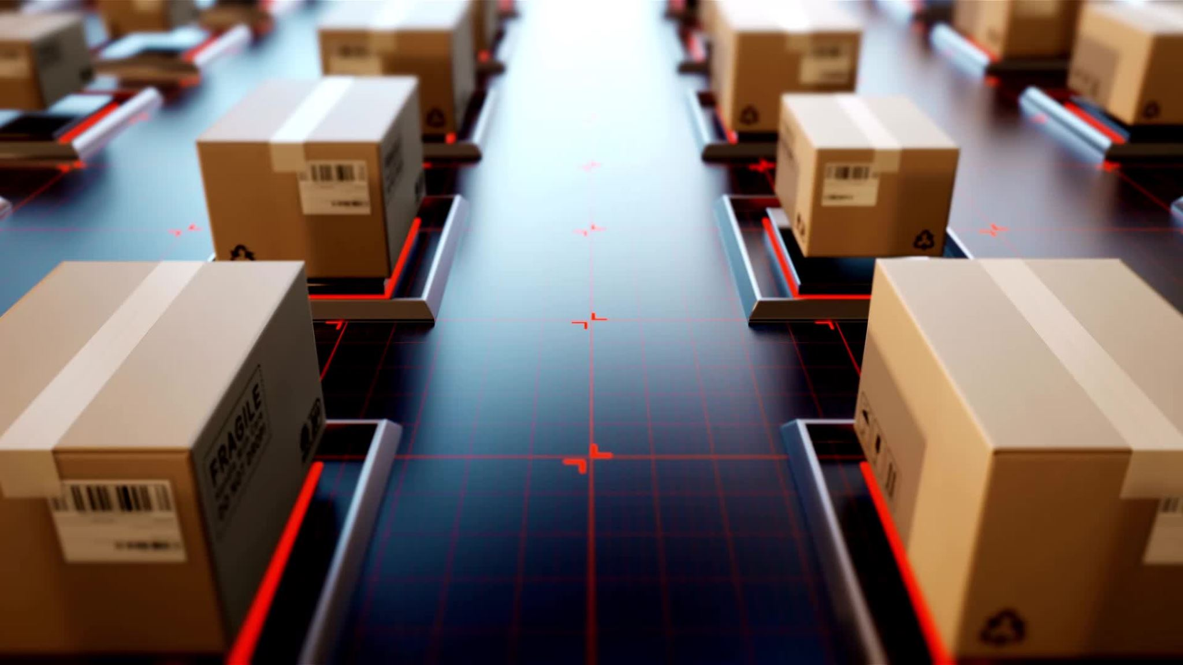
CARGONOMICS (1313)
PROBLEM STATEMENT:OVERLOADING AND UNDERLOADING OF RAILWAY WAGONS
SOLUTION : WE ADDED A LOAD SENSOR TO CHECK THE WEIGHT AS WELL AS DISPLAY WITH A CHART SHEET SO THAT ALL RECORDS ARE BEEN MAINTAINED
WE ALSO ADDED AUTOMATIC DOORS OF STAINLESS STEEL
AND A PUSHBOTTON WHICH WOULD HANDLED BY THE DRIVERS OR THE WORKERS TO SOLVE THE PROBLEM OF OVERLOADING AND UNDERLOADING .
This Photo by Unknown author is licensed under CC BY-SA.

Slide 2


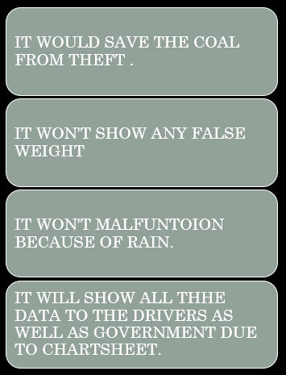
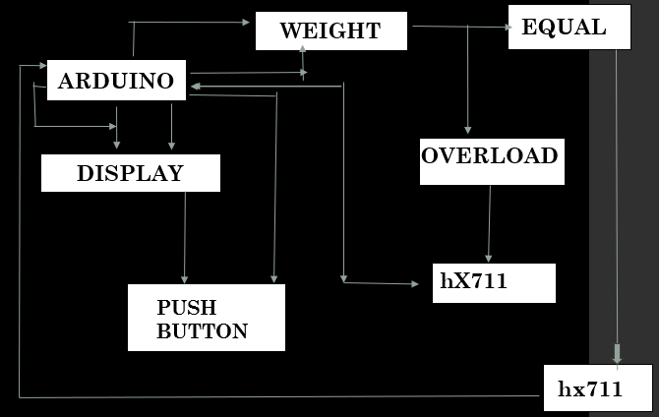
Github Link = https://github.com/HarshKumar-maker/Cargonomics.git

